Slide 1
Switched Lan’s Example

Slide 2
We will set up switched LANs using two different switching devices: hubs and switches.
A hub forwards the packet that arrives on any of its inputs on all the outputs regardless of the destination of the packet.

Slide 3
On the other hand, a switch forwards incoming packets to one or more outputs depending on the destination(s) of the packets.
We will see how the throughput and collision of packets in a switched network are affected by the configuration of the network and the types of switching devices that are used.

Slide 4
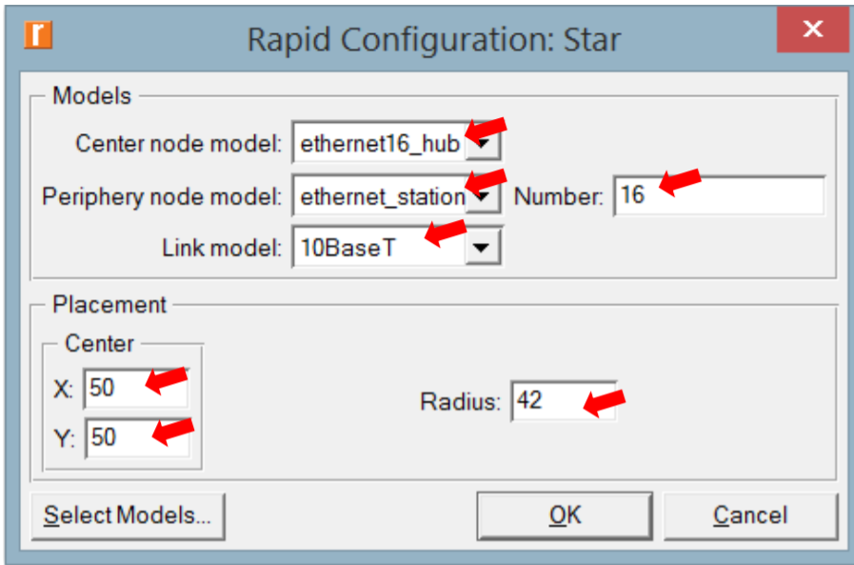
Node Model Configuration
We created a x=50, y=50, r=42 circular network with 16 nodes operating at 10 Mbps.
The prefix ‘’ethernet16’’ indicates that the device supports up to 16 Ethernet connections.
The ‘’10BaseT’’ link represents an Ethernet connection operating at 10 Mbps.

Slide 5
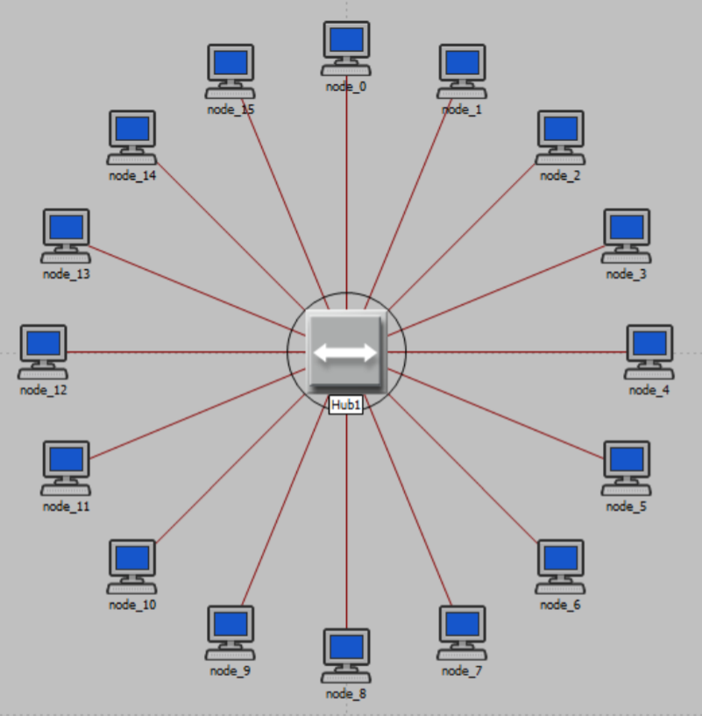
Network Model
This is our simulation network model as result of our previous configurations.

Slide 6
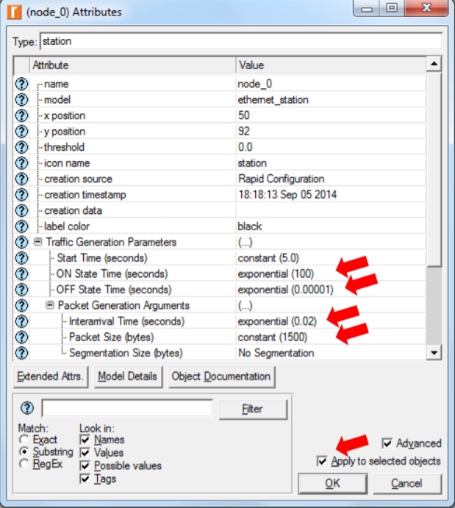
Node Attributes
We select all our nodes and edit their shown attributes.
On State time= exp 100 sec
Off state time= 0.00001 sec
Interarrival time = exp 0.02 sec
Packet Size = constant 1500 bytes

Slide 7
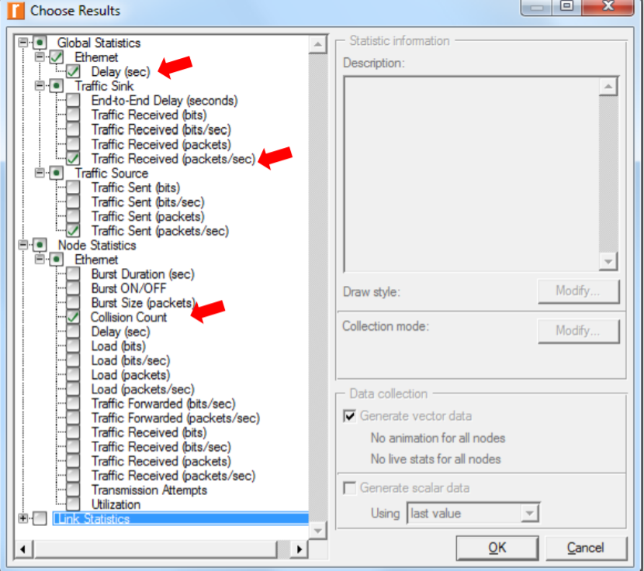
Statistics
We select the statistics we want to be collected during the simulation.

Slide 8
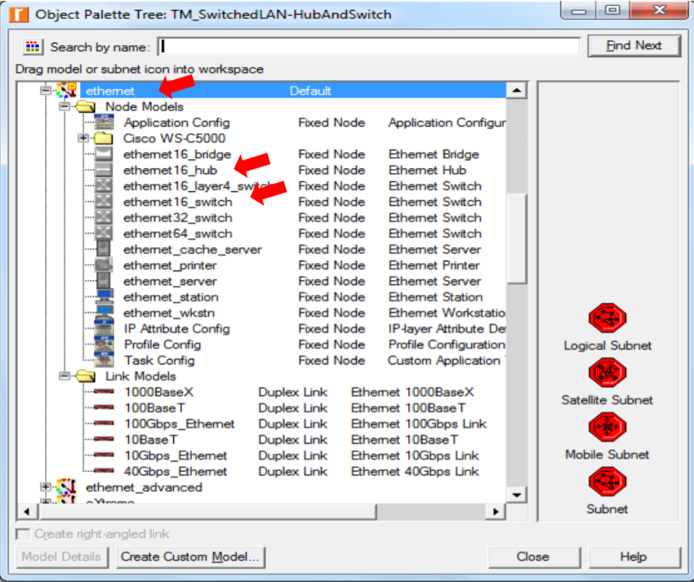
Object Palette Tree
The network we just created utilizes only one hub to connect the 16 stations.
We need to create another network that utilizes a switch and see how this will affect the performance of the network.
To do that, we will create a duplicate of the current network model.
We add one more hub and a switch to our new scenerio.

Slide 9
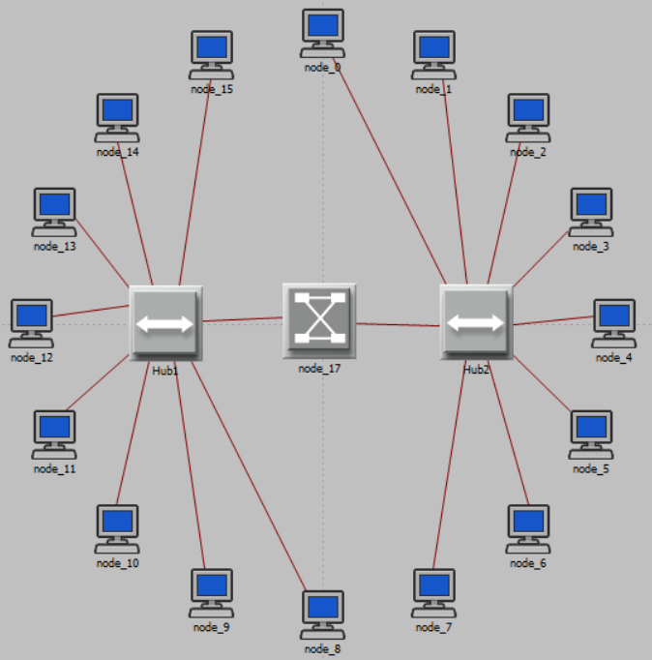
We will remove all links by selecting them and hitting the Delete key.
Then we will add new links, using the 10BaseT link available in the Object Palette.
After reconfiguring the network of the HubAndSwitch scenario, it will look like this.

Slide 10
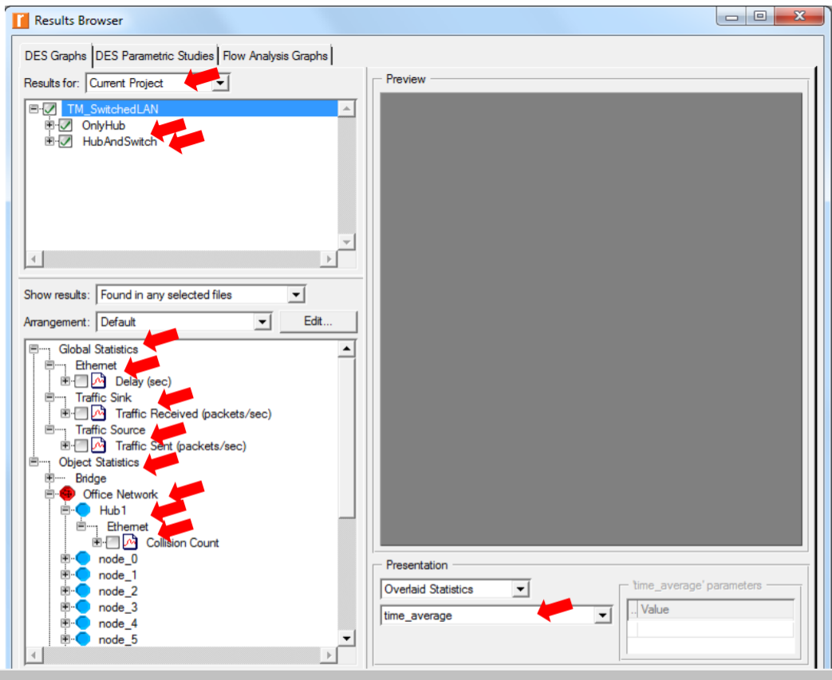
Viewing Result
We configure the duration of the simulation to 2 minutes and press run.
Then we select Traffic Sent, Traffic received, Object Statics and Collision Count statistic. Afterwards, we change Presentation setting to ‘’time_average’’.

Slide 11
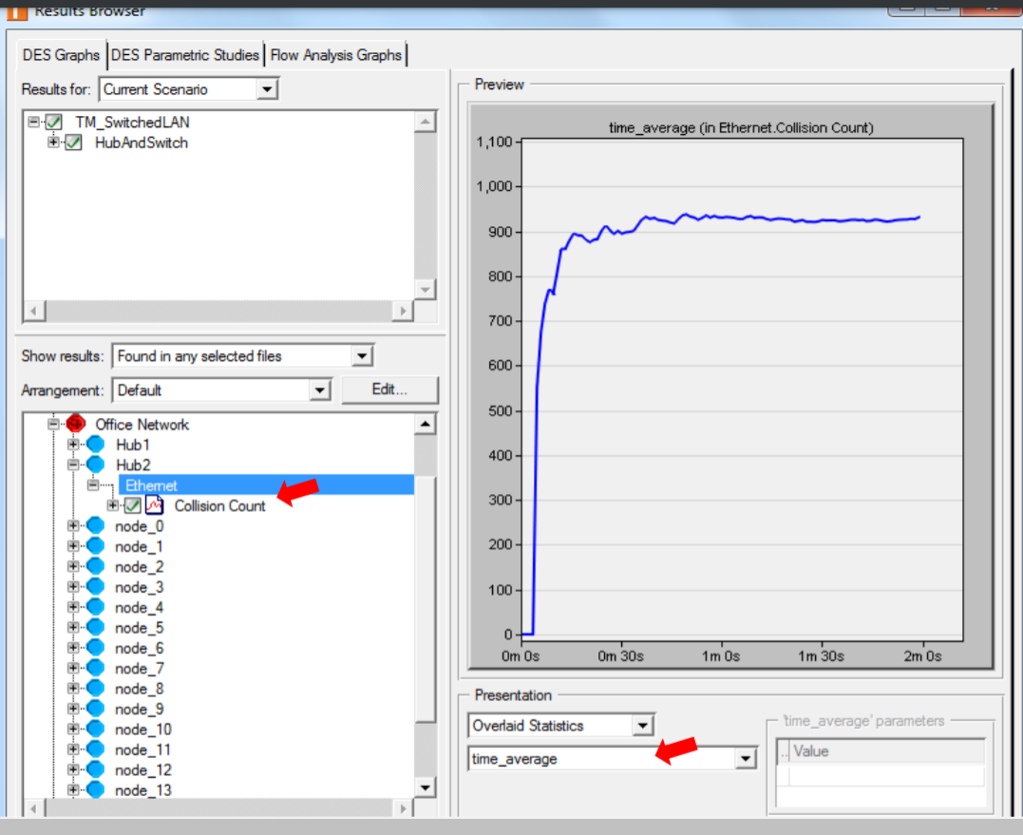
Result Browser
We select the Collision Count statistic for Hub1 and click Show.
time_average is the average value over time of the values generated during the collection window. This average is performed assuming a “sample-and-hold” behavior of the data set

Slide 12
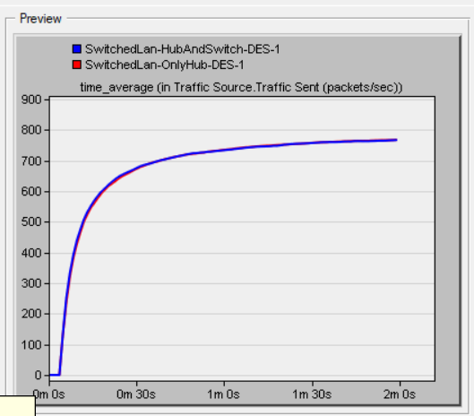
Traffic Source Sent
The resulting graph should look like the one here.
As you can see, the traffic sent in both scenarios are almost identical.

Slide 13
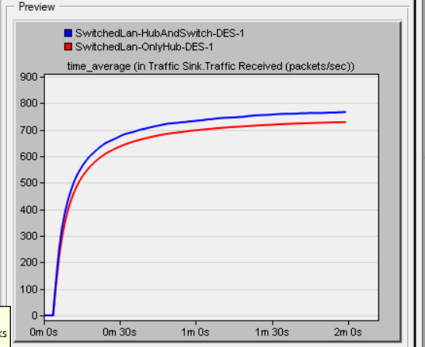
Traffic Sink Received
We select the Traffic Received statistic and click Show.
As you can see, the traffic received in the HubAndSwitch scenerio is slightly higher than the OnlyHub scenario.

Slide 14
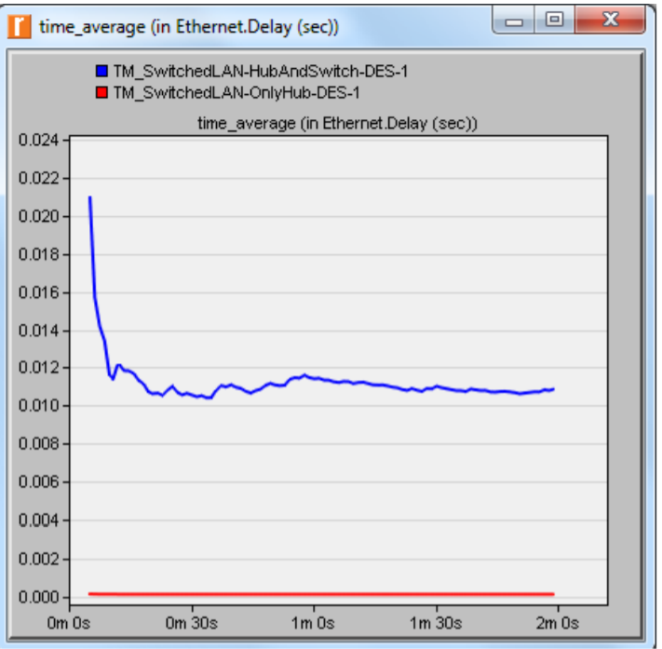
Ethernet Delay
We select the Delay statistic and click Show. (Result may vary slightly due to different node placement in different runs.)
OnlyHub scenerio has lower Ethernet delay per time to HubAndSwitch network.

Slide 15
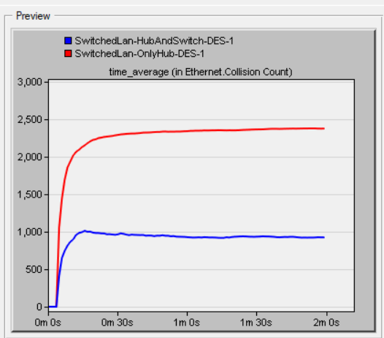
Ethernet Collision Count
We can see the average time in Ethernet collision time.
HubAndSwitch network has lower collision per time.

Slide 16
Questions
Why adding a switch makes the network perform better in terms of throughput and delay?
When a switch is added to our second scenario, all traffic generated at any node is directed to its destination node. As a result, no traffic is propagated. Switches improve throughput and latency in networks.
We analyzed the collision counts of the hubs. Can you analyze the collision count of the “Switch”?
Switches are not “shared media” devices but hubs are. We are unable to examine the Switch's collision count. The switch splits the network into several segments and maintains simultaneous connections of several pairs of computers that do not compete for network bandwidth with other pairs of computers. When the switch receives the packet, it uses the destination address information in the header to forward it to its intended destination. As a result, each port in Switch has its own bandwidth allocation. Using a switch, several connections may be handled separately. Since the switch does not share the transmission media, there are no collisions in the network.

Slide 17
Reference
Emad Abolela.(2003).Network Simulation Experiments Manual.
Youtube-King Tutorials.(2016).Riverbed Opnet 17.5 Tutorial - Switched Lan.

